Slide 1



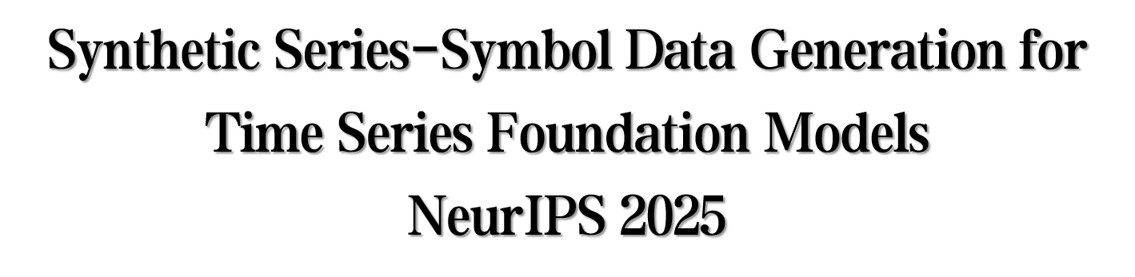

Notes:
hello, everyone, bulabulabula

Slide 2
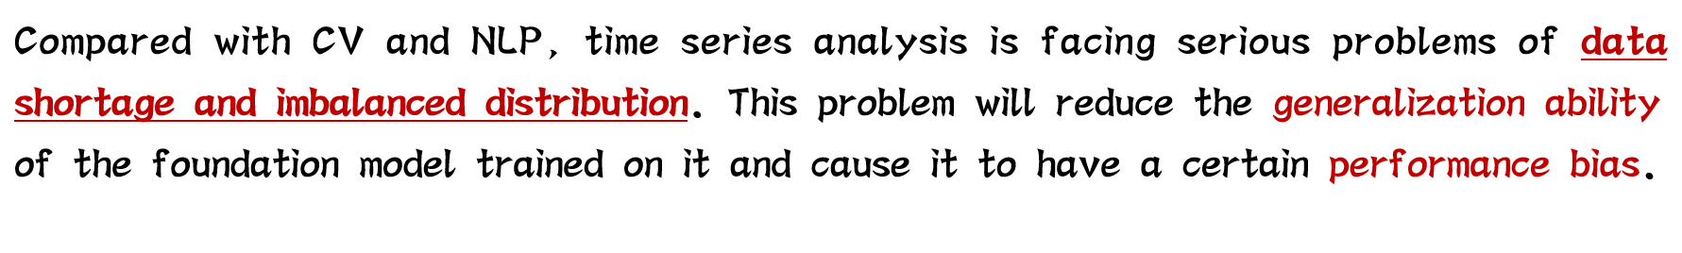
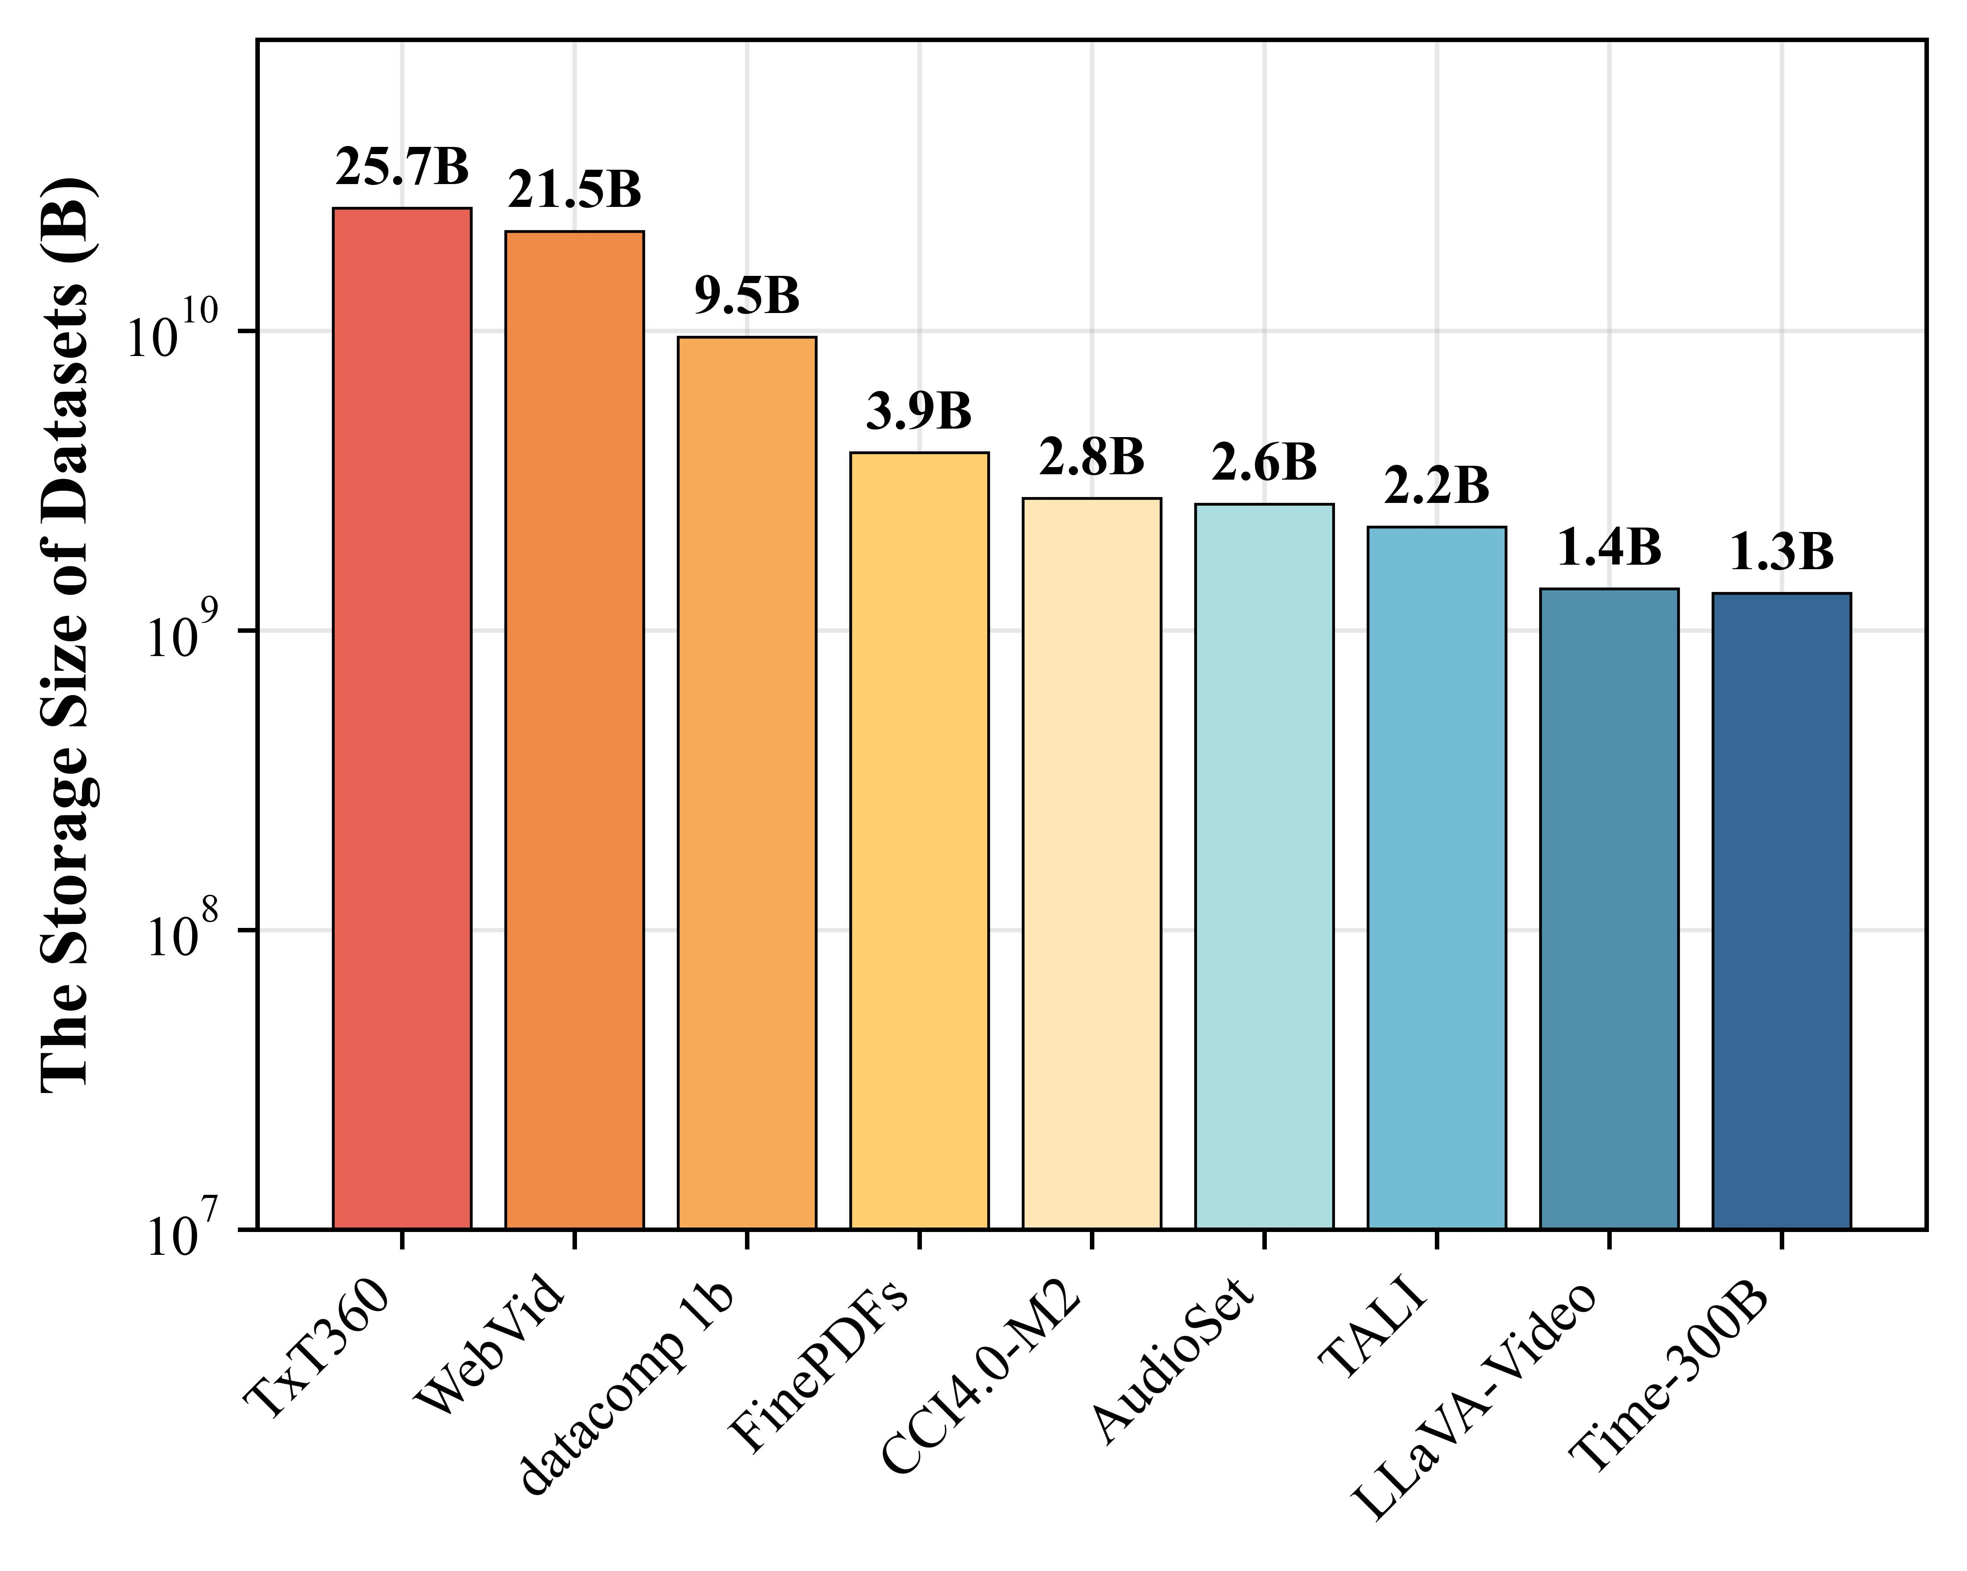
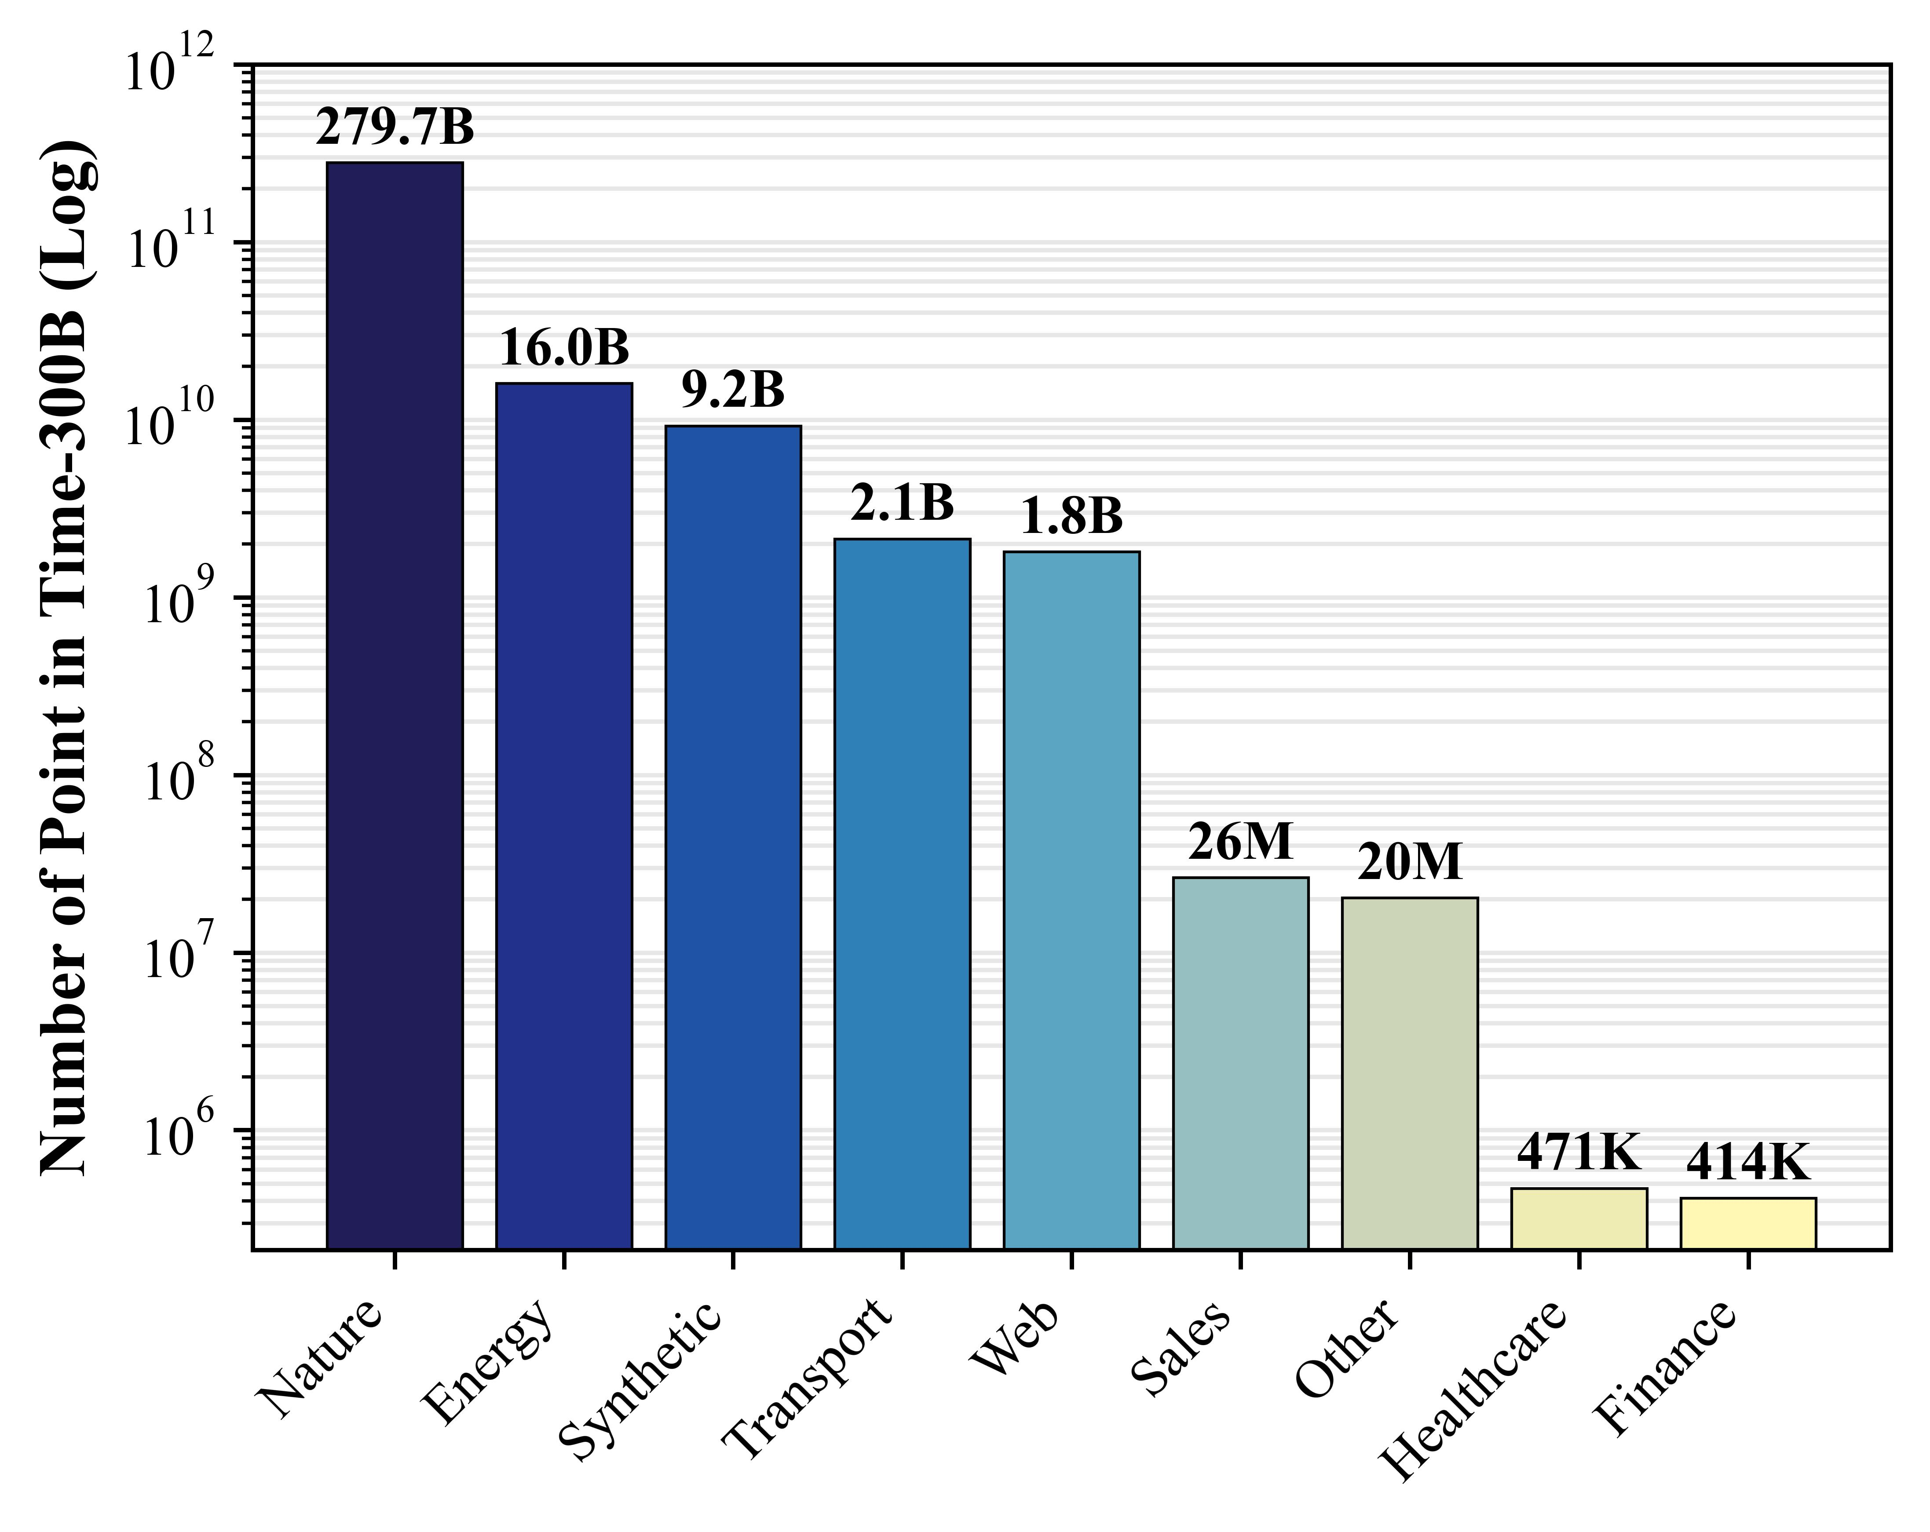

Notes:
First, let's discuss our research motivation. The Training Data is the fundamental guarantee for our deep learning. Compared with computer vision and natural language processing, time series analysis is facing serious problems of data shortage and imbalanced distribution. This problem will reduce the generalization ability of the foundation model trained on it and cause it to have a certain performance bias.

Slide 3
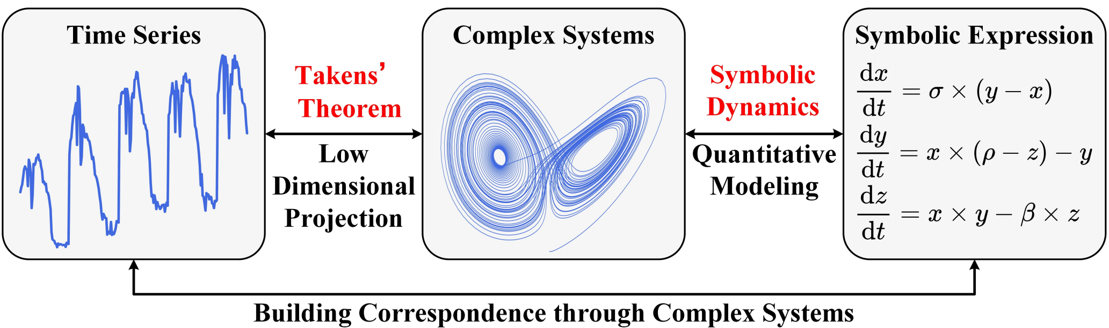
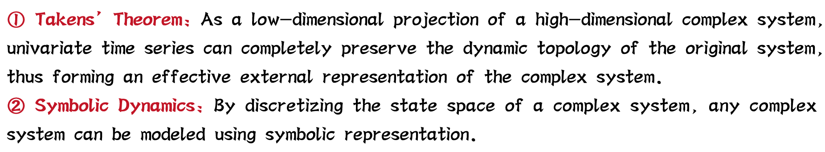
Notes:
To address the aforementioned issues, we introduce a complex dynamics perspective from time series analysis. On one hand, based on Takens' theorem, we argue that low-dimensional time series are an external representation of high-dimensional complex systems. On the other hand, based on symbolic dynamics theory, we can model complex systems using symbolic expressions, namely ordinary differential equations and partial differential equations.
Based on these two theories, we can establish a relationship between time series and symbolic expression, using complex systems as a bridge. This leads us to propose an unrestricted, high-quality data generation mechanism to alleviate the problems of data shortage and imbalanced distribution.

Slide 4
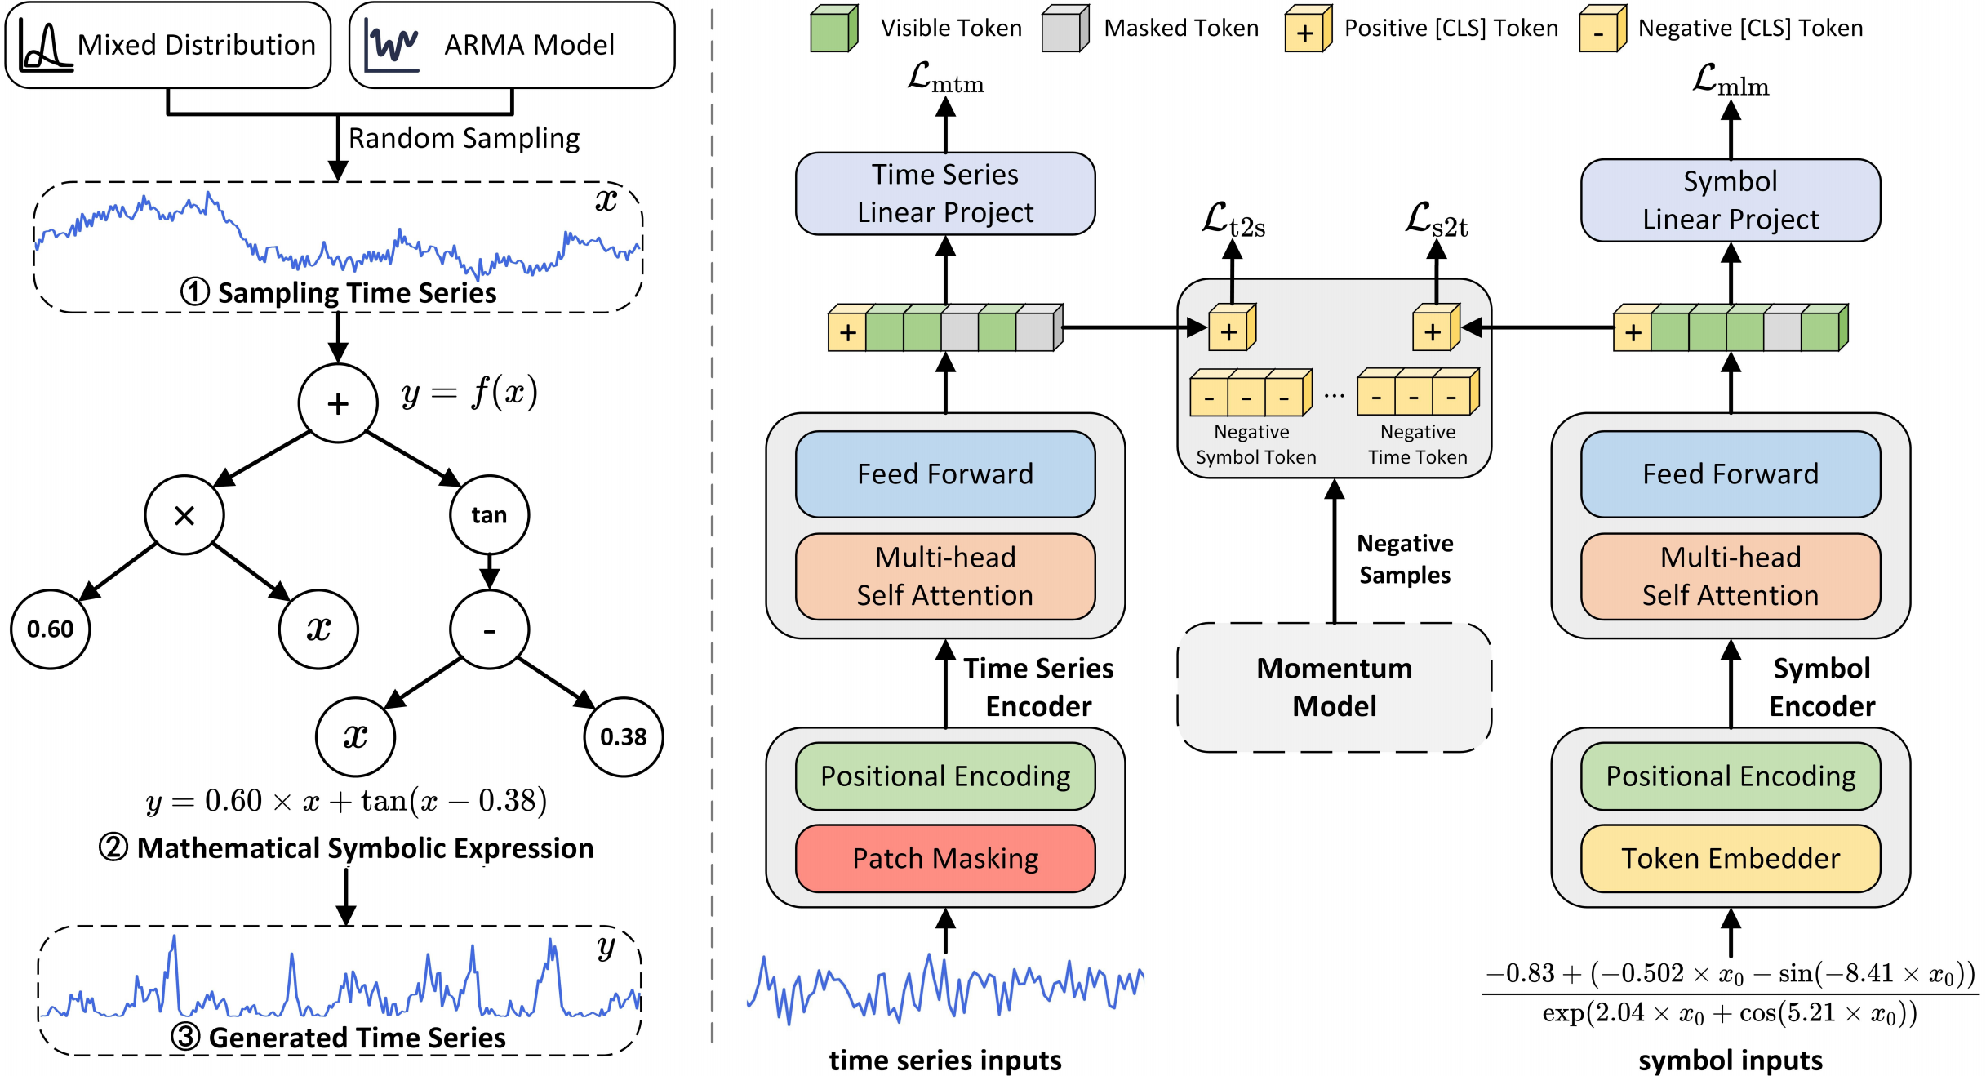
S2Generator: https://github.com/wwhenxuan/S2Generator
SymTime: https://github.com/wwhenxuan/SymTime
Notes:
This is an overview of the proposed method. The left side shows our unrestricted data generation mechanism, and the right side shows our pre-training paradigm based on the corresponding data.
We believe that symbolic expressions are naturally tree-structured so we can construct it using binary trees. Then we randomly generate excitation timefrom mixed distributions and ARMA models and input them into our complex system to obtain response time series.
A key point is that we believe there is a pairing relationship between the time series and the symbolic expression that generated it. Therefore, we construct a Transformer model with a dual-encoder architecture to learn the basic representation of the data.

Slide 5
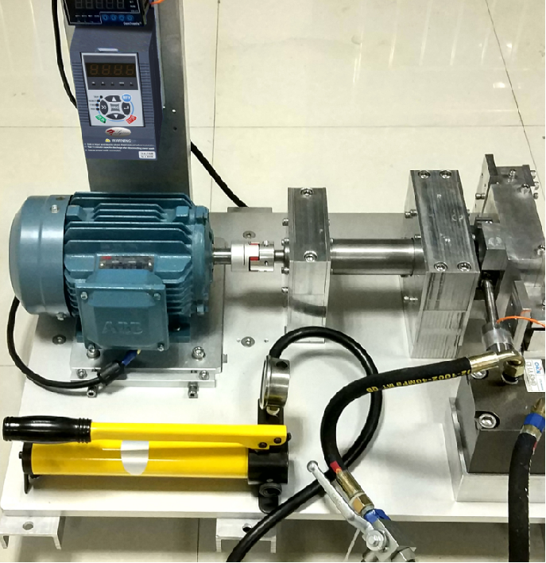
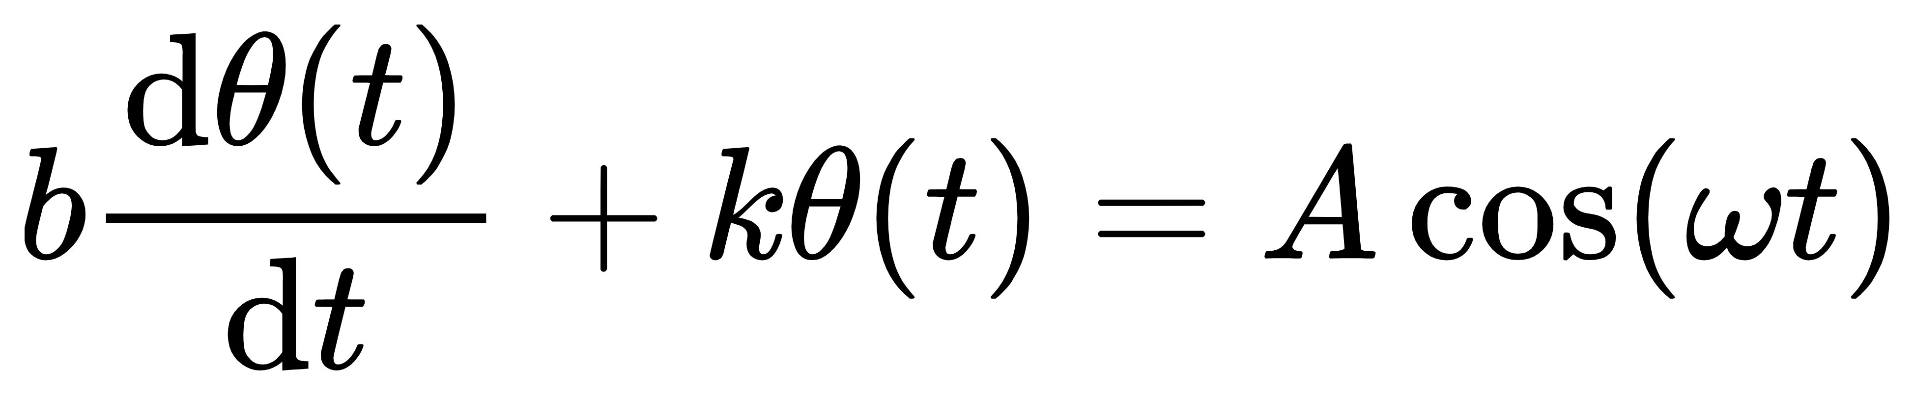

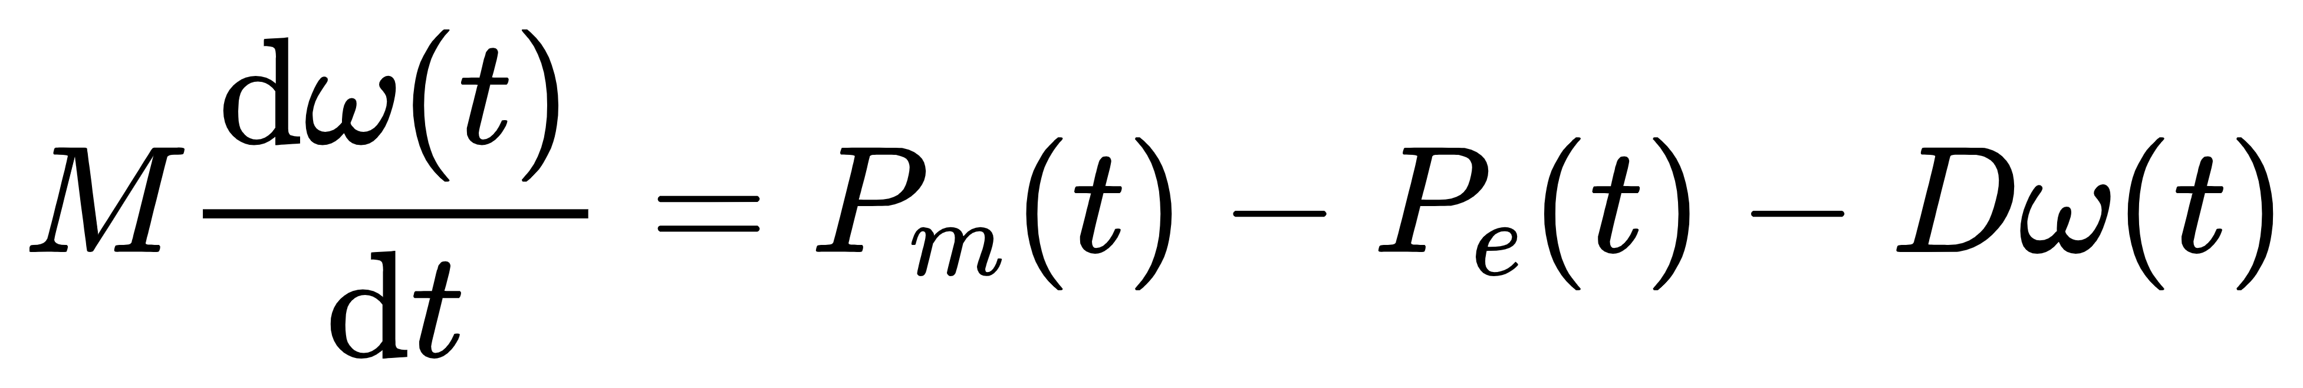
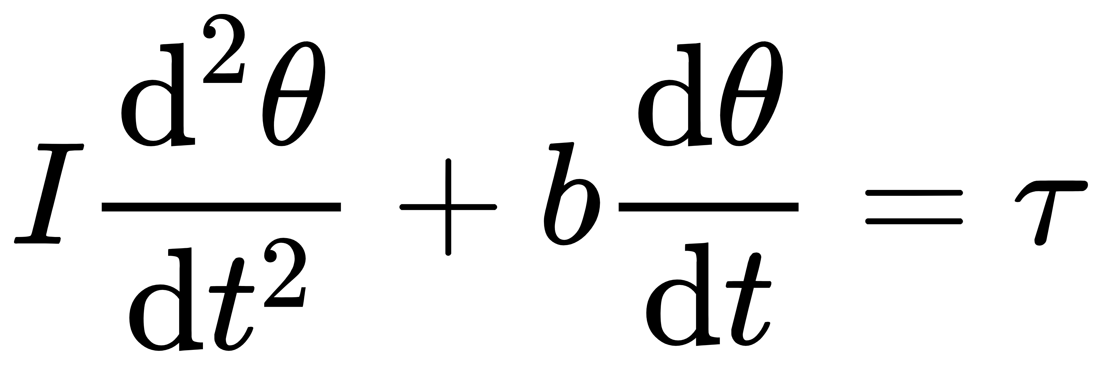
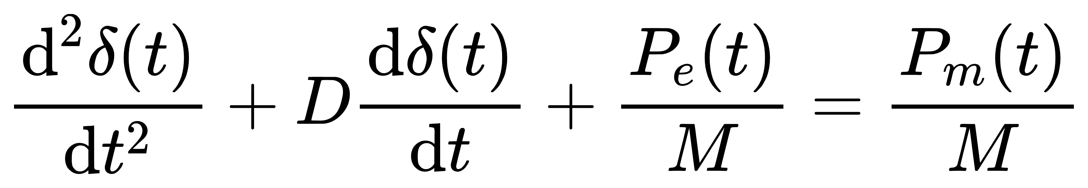
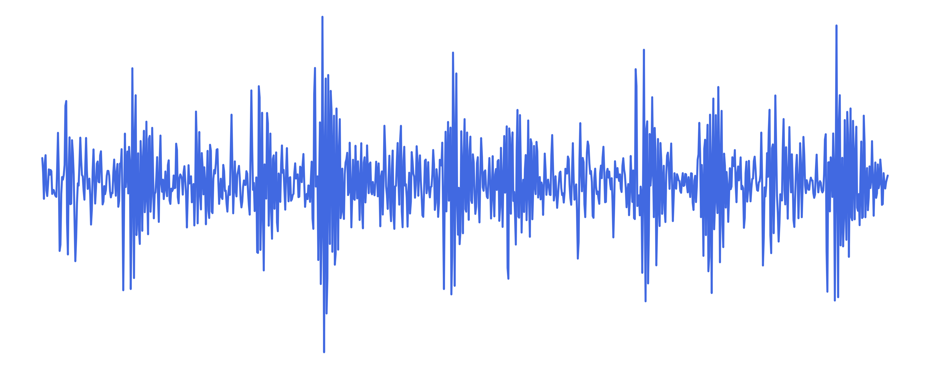
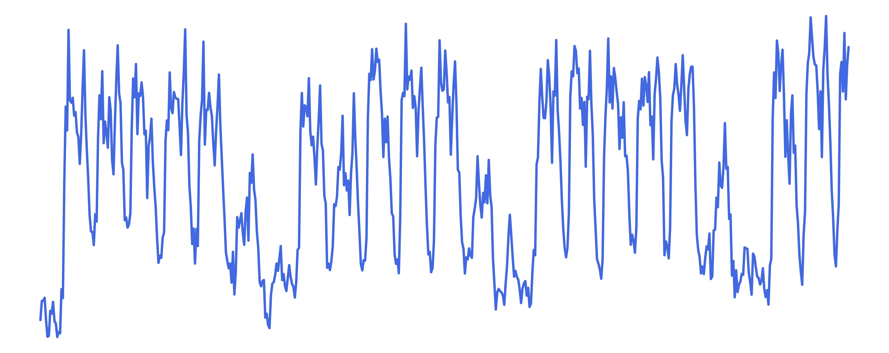

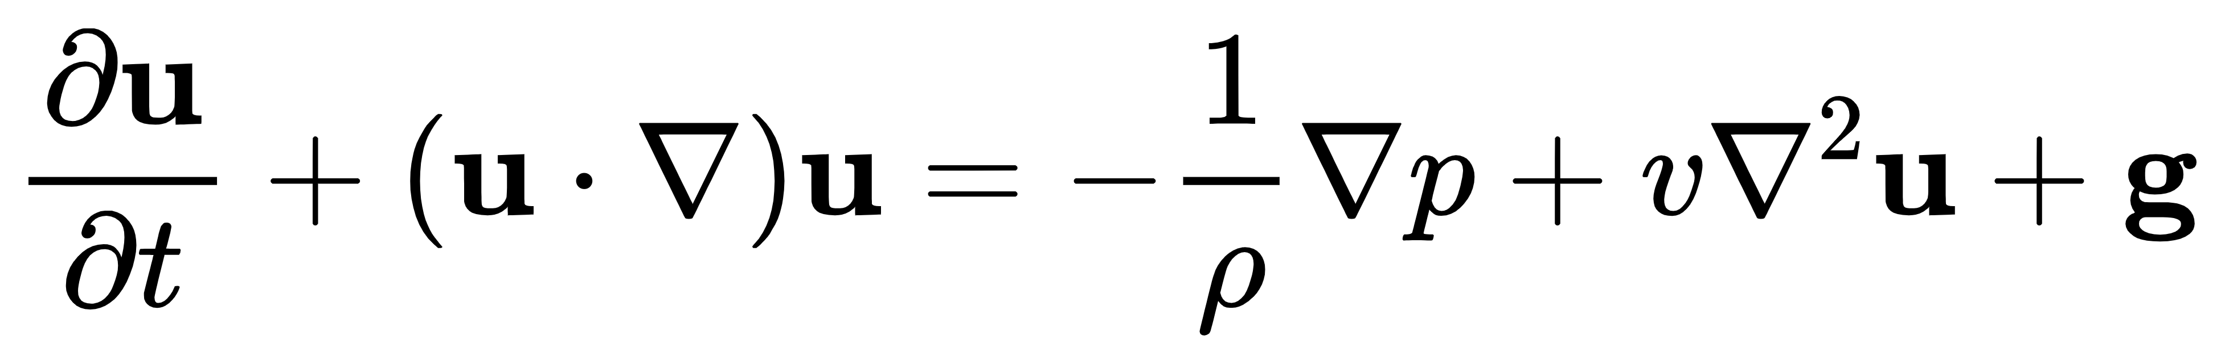

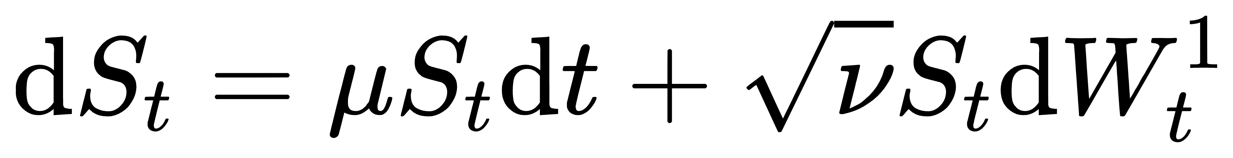
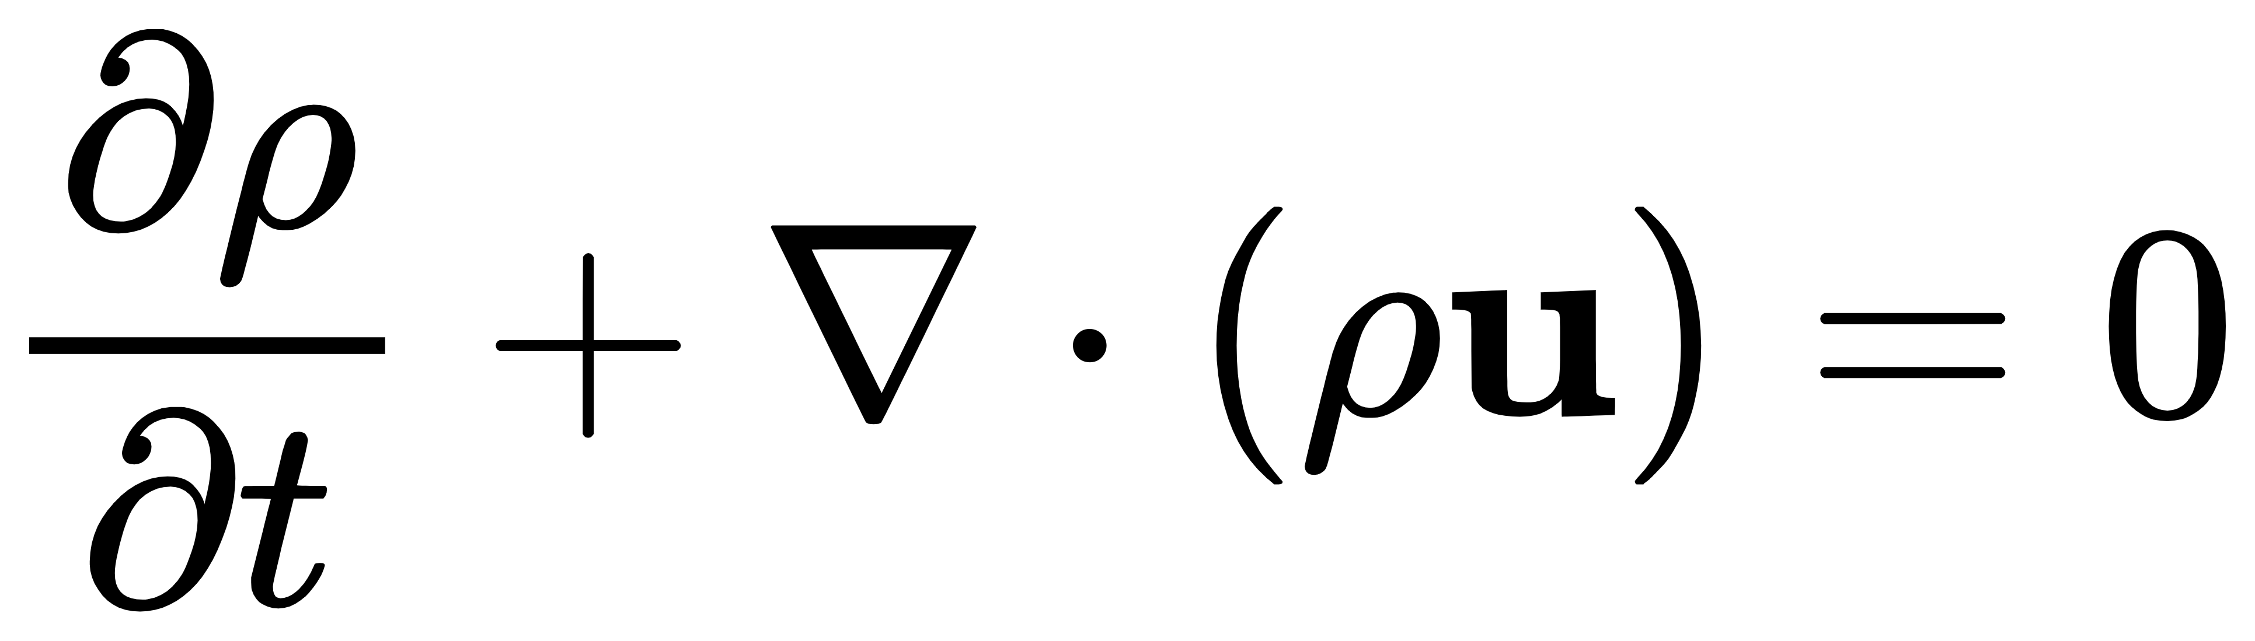
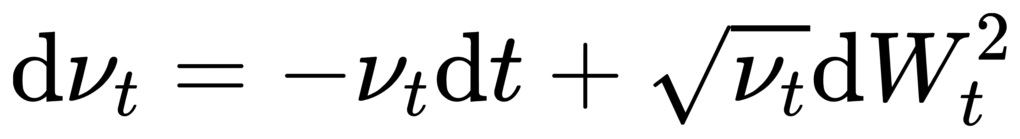
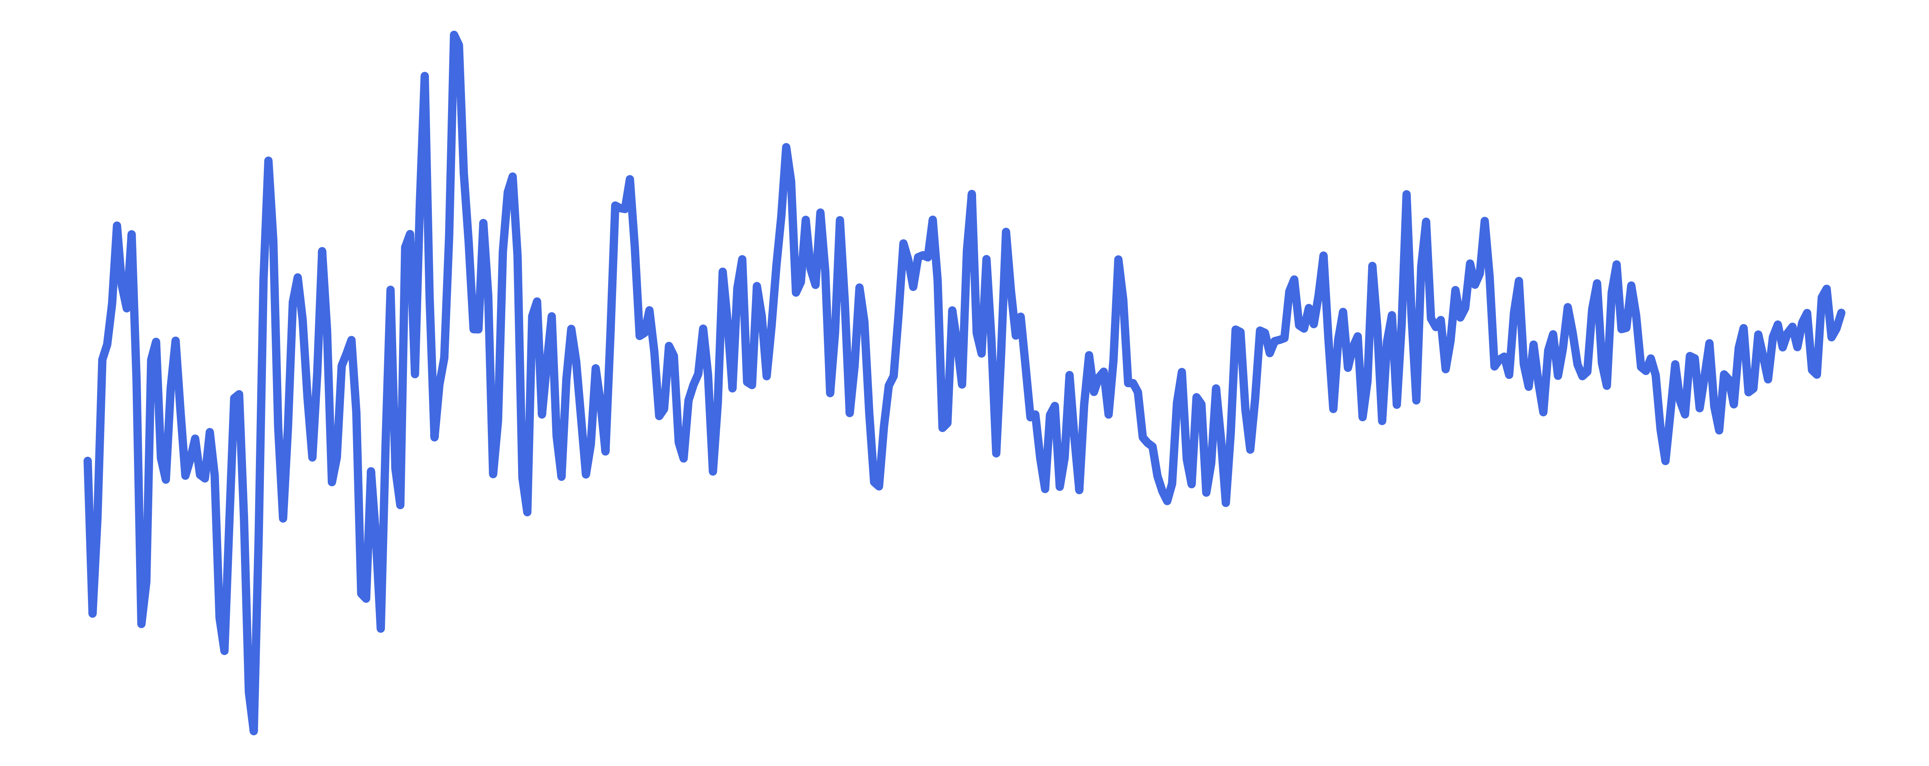
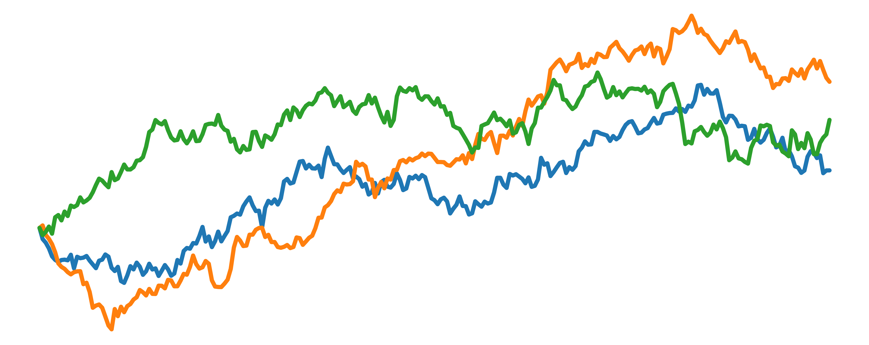
Rotating Bearing System
Power Transmission System
Turbulent Flow Rate
Random Fluctuations in Finance
Notes:
Compared to other data generation mechanisms, our mechanism is more aligned with the fundamental nature of time series. Since time series are a fundamental external representation of complex systems, and the symbolic expressions we construct can reflect the physical properties of the real world.
For example, our symbolic expressions can generate a second-order forced vibration equation to produce vibration signals from a rotating bearing, or a Wiener-Stokes equation to simulate the velocity of turbulent flow. These all have practical physical significance.

Slide 6
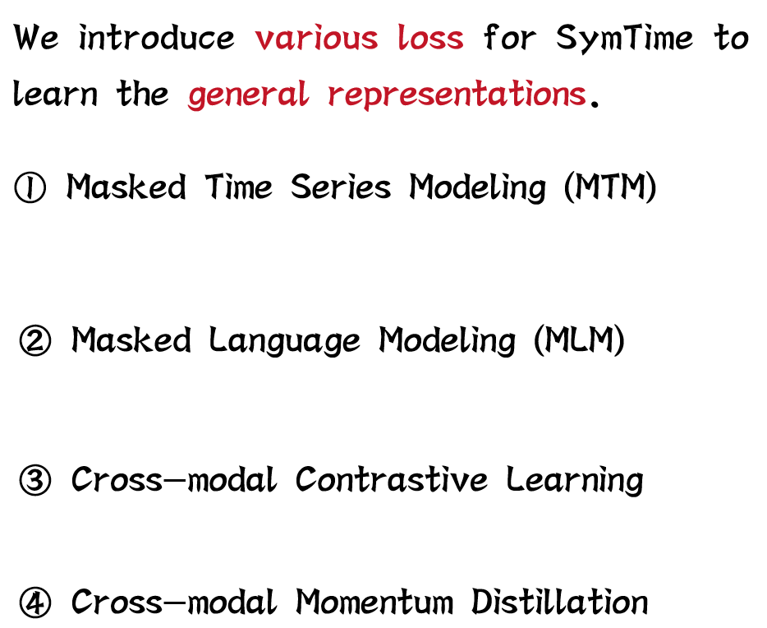
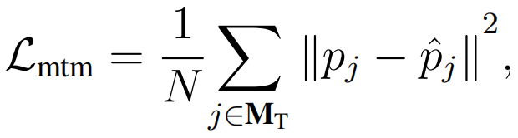
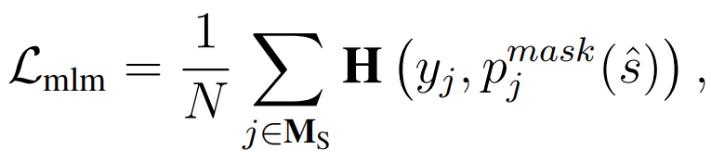
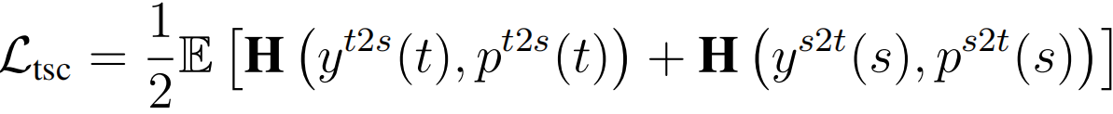
Notes:
In our SymTime, we introduce four different pre-training objectives.
First, masked time series modeling and masked natural language modeling are used to enable encoders of the two modalities to learn the basic representations of the corresponding data.
Subsequently, we use cross-modal contrastive learning and momentum distillation to teach the time series encoder the semantic information of symbolic expressions from the outputs of both modalities.

Slide 7
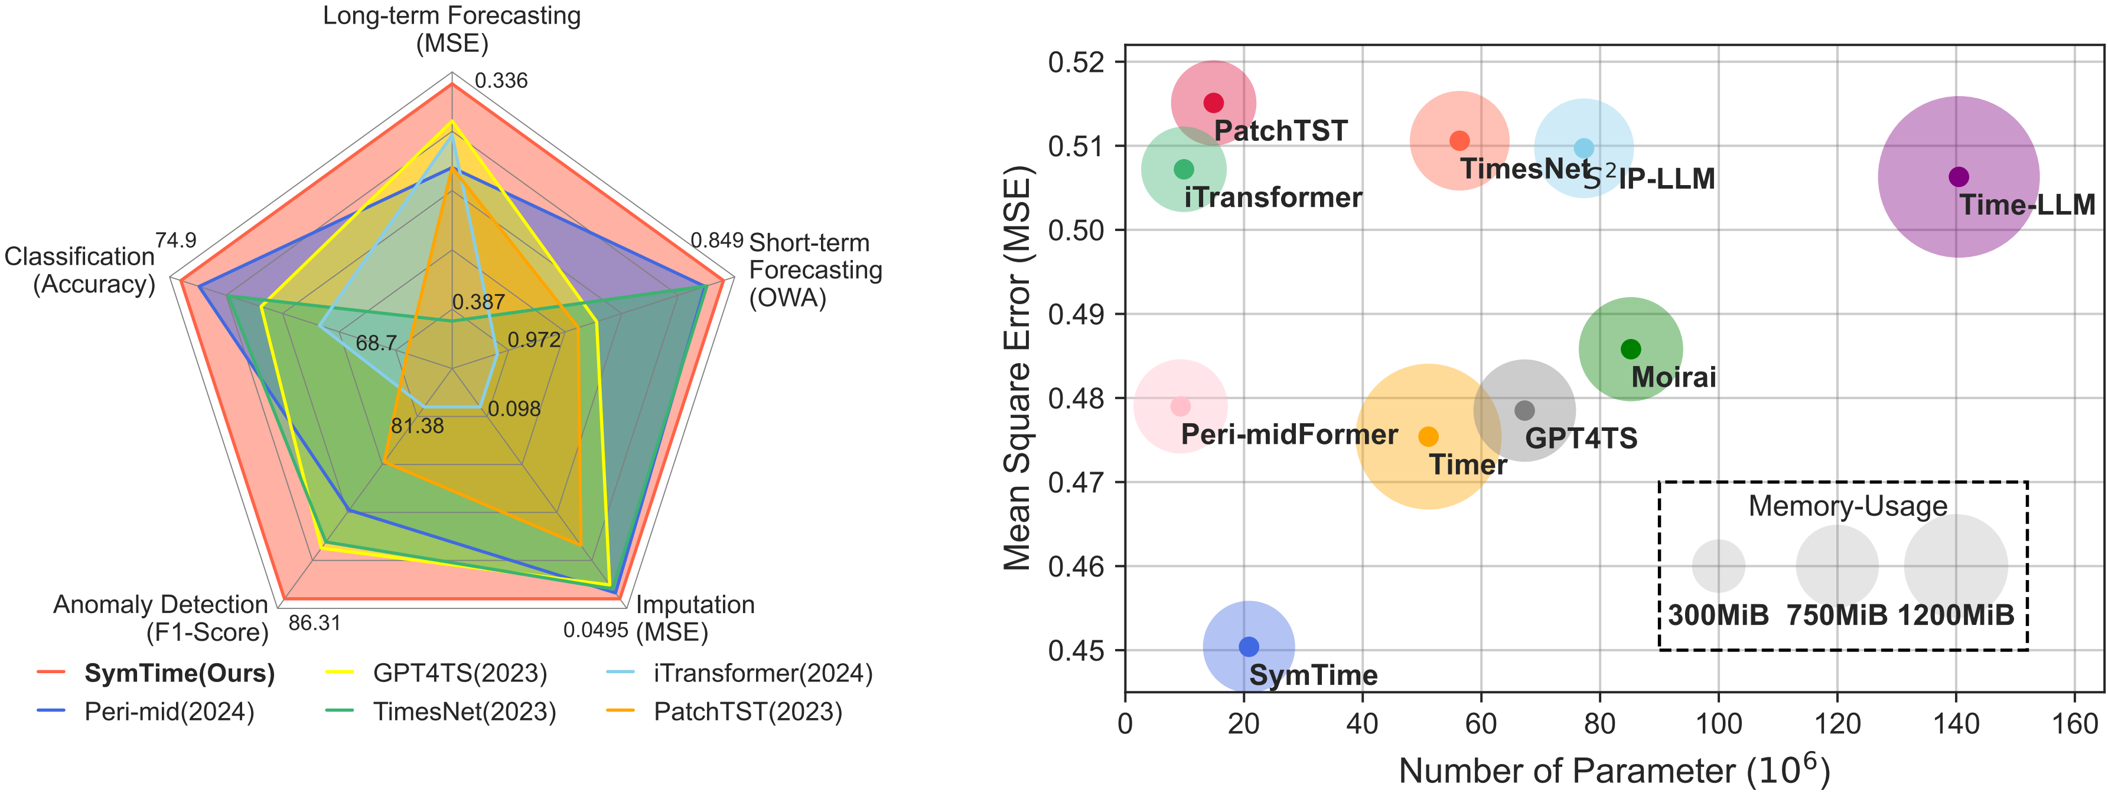
Experiment Results
Notes:
The following is our experimental verification section. Our pre-trained SymTime achieved state-of-the-art results on five different time series analysis tasks.

Slide 8
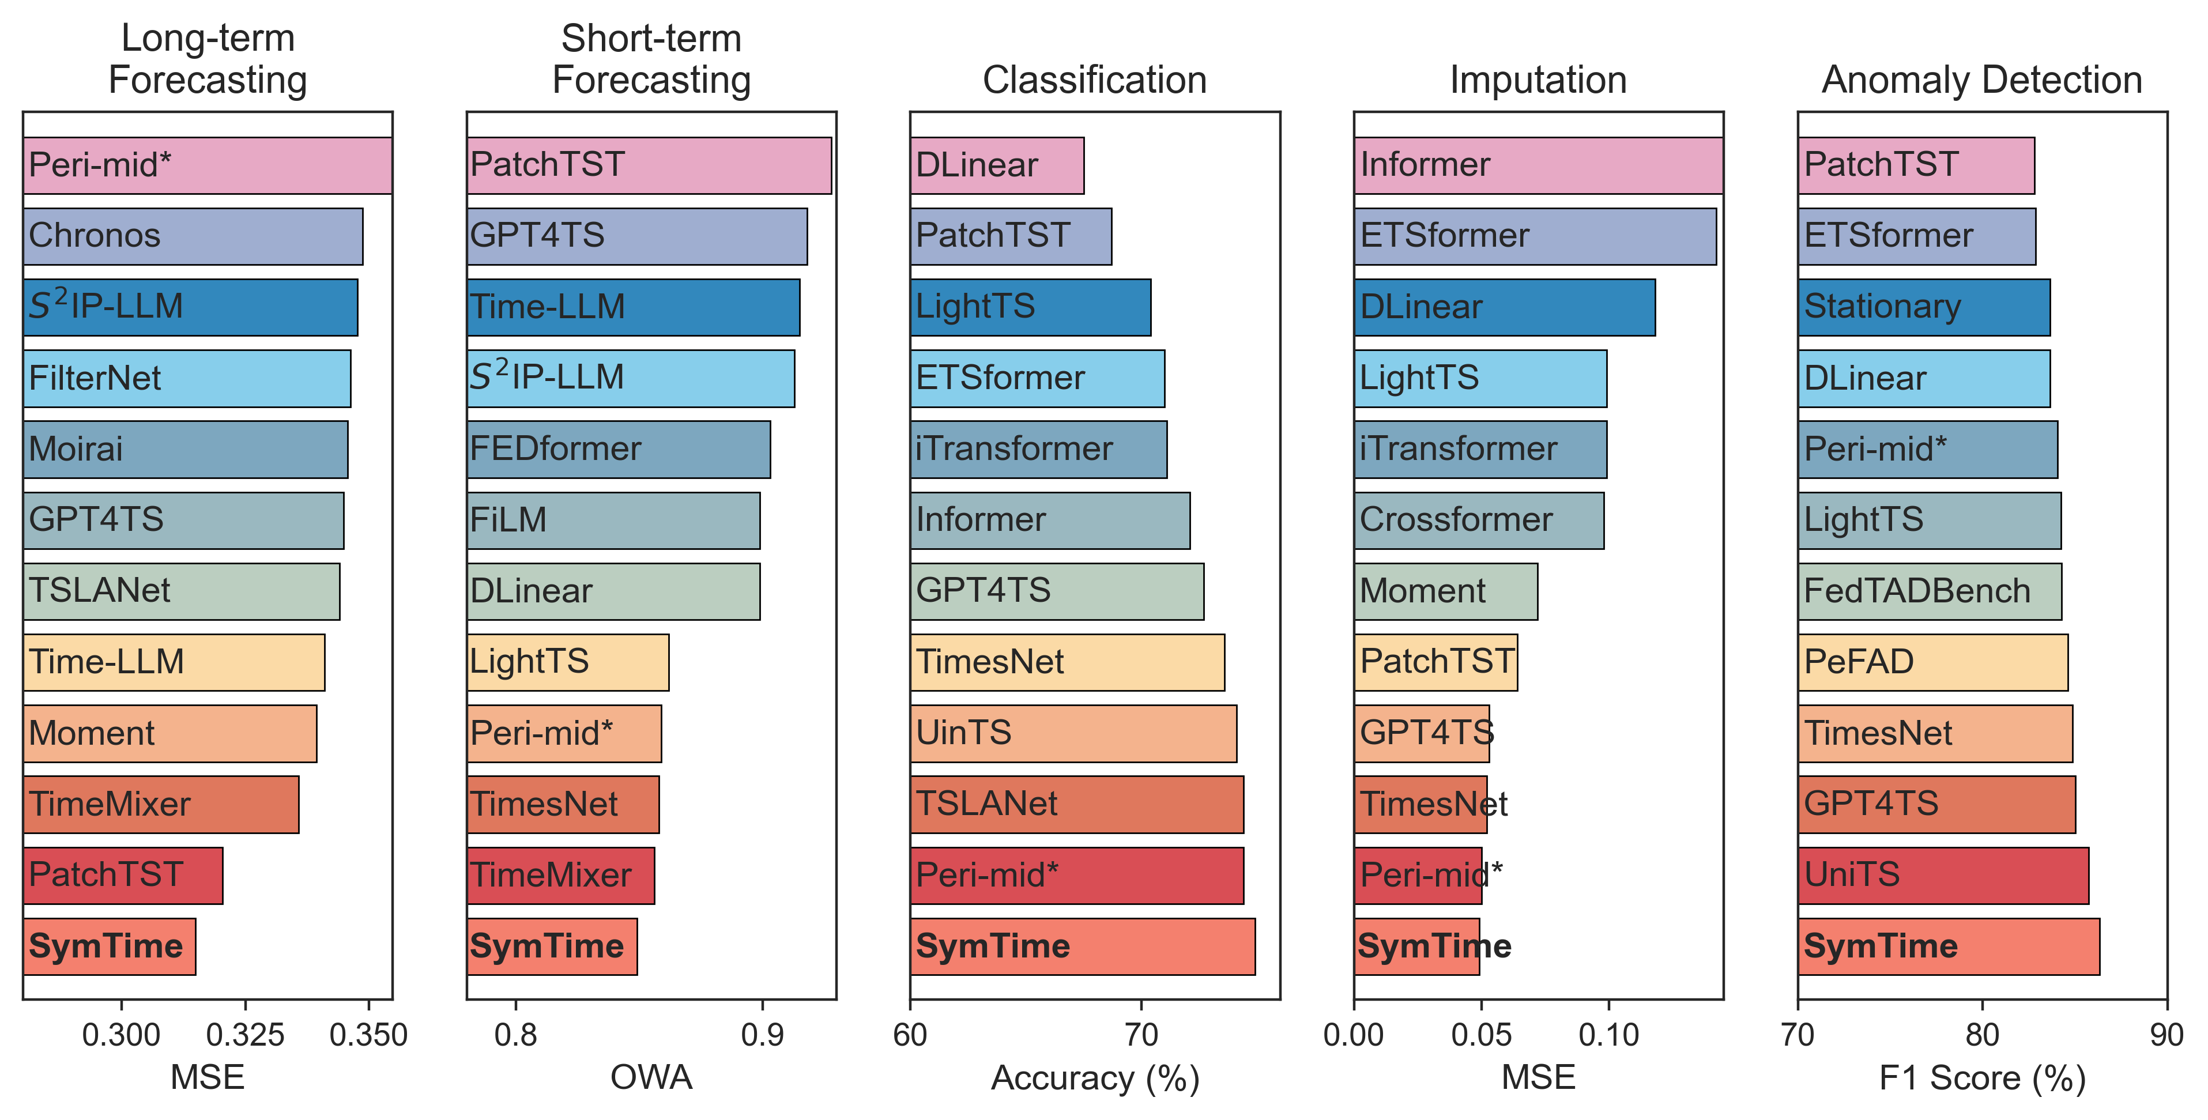
Notes:
Here are the results of our more complete benchmark experiment.
In addition, we conducted ablation experiments and studied scaling laws, which can be found in our paper.

Slide 9
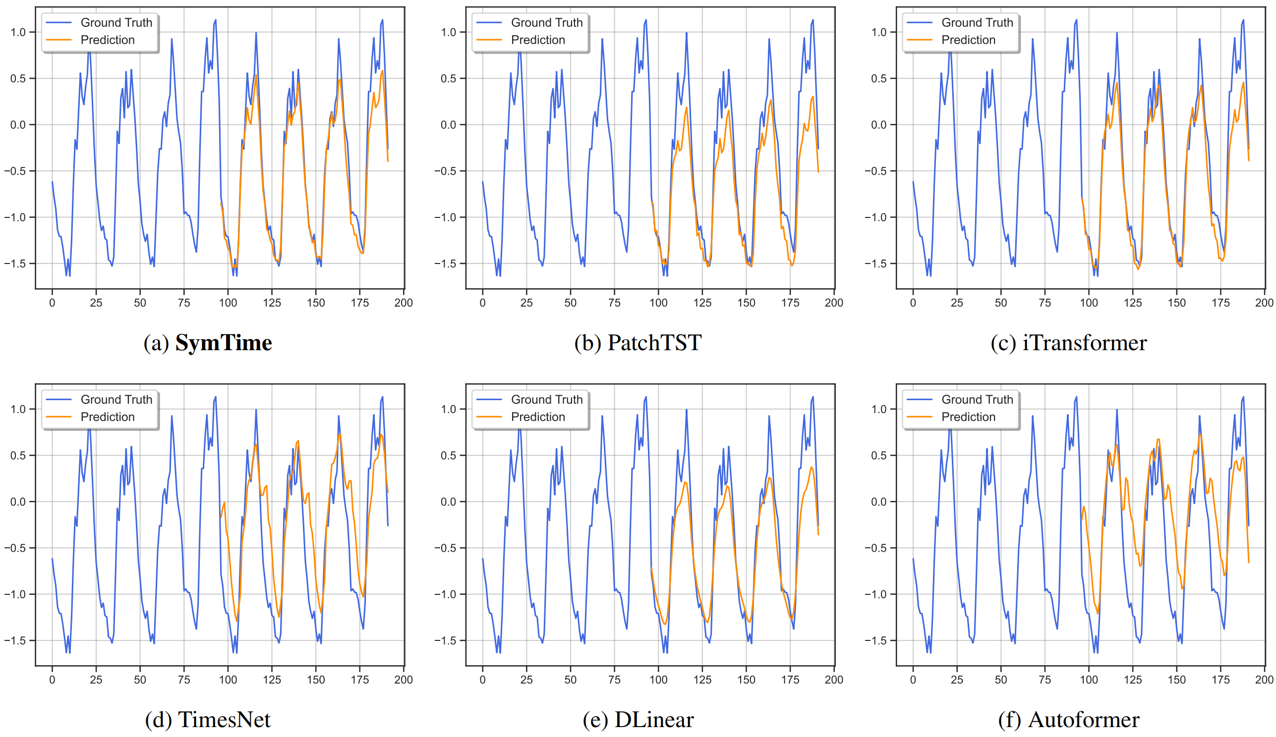
Notes:
We visualized the model forecasting results, which shows that SymTime can achieve more accurate predictions compared to other models.

Slide 10
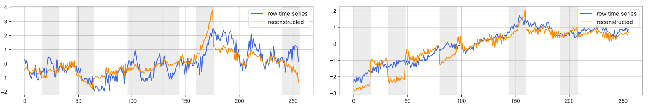
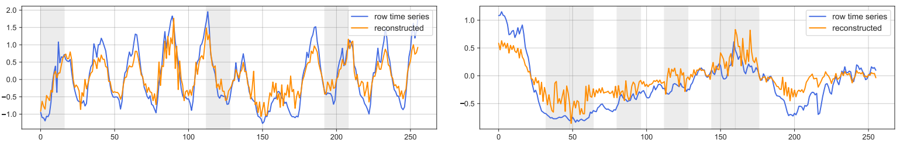
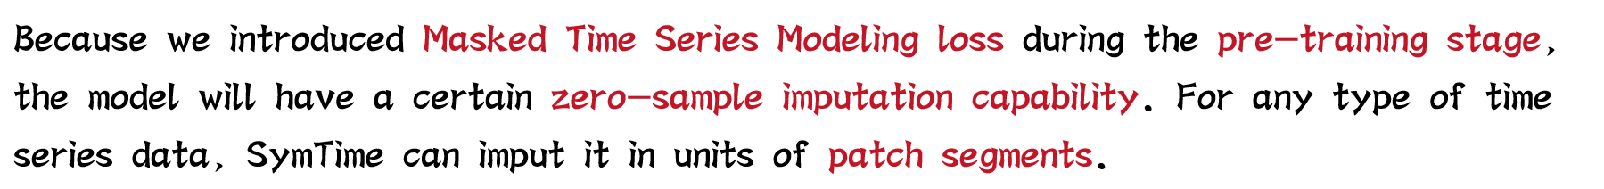
Zero-shot Imputation
Because we introduced Masked Time Series Modeling loss during the pre-training stage, the model will have a certain zero-sample imputation capability. For any type of time series data, SymTime can imput it in units of patch segments.
Notes:
Here we verify the zero-sample imputation capability of masked time series modeling, which SymTime can perform zero-sample masking on a patch-by-patch basis.

Slide 11
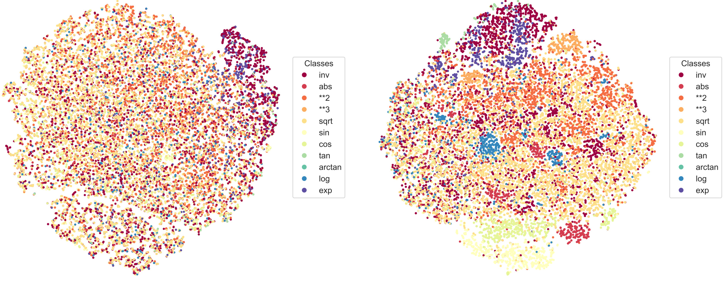
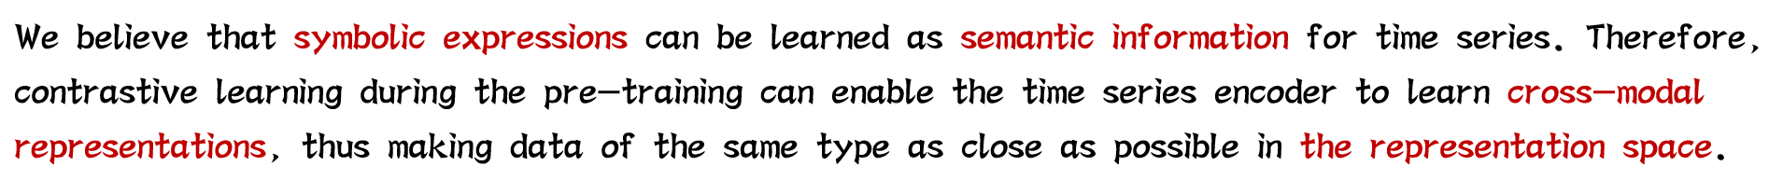
Notes:
Finally, we conducted a representation learning experiment to verify the impact of cross-modal contrastive learning on the representation space of the time series encoder.
It can be seen that the representation space of the model changed significantly before and after pre-training.

Slide 12


Email: whenxuan@ieee.org

